Slide 1
Our school facilities
6
Lesson 1 – Period 1

Slide 2
Table of contents
Warm-up
01
02
03
Activity 3 Let’s talk.
04
Activity 1 Look, listen and repeat.
Game
05
Activity 2 Listen, point and say.

Slide 3
01
Warm-up

Slide 5
02
Activity 1
Look, listen and repeat.

Slide 6
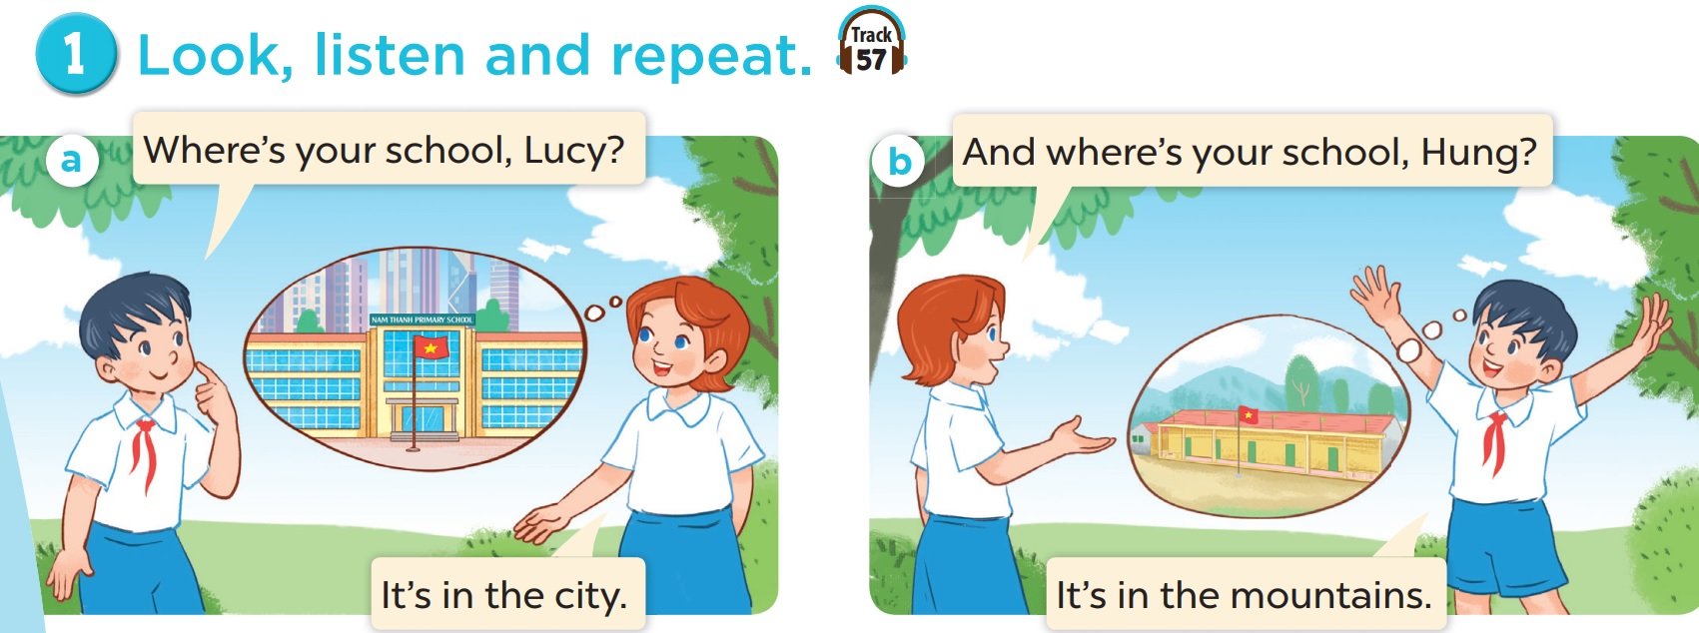
Hung and Lucy are talking about their schools.
Listen.

Slide 7
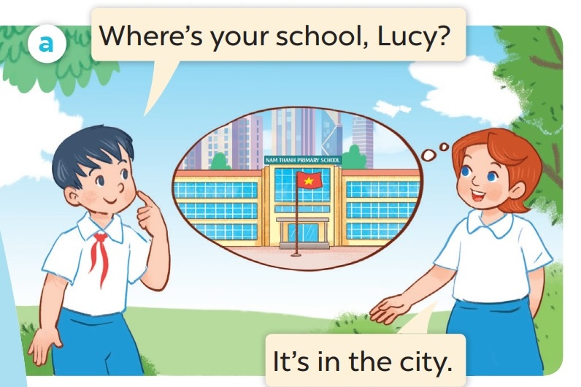
Listen and repeat.

Slide 8
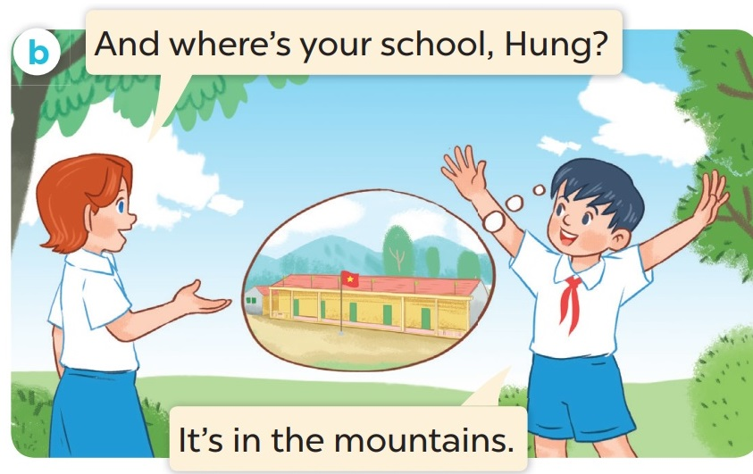
Listen and repeat.

Slide 9
Where is Lucy’s school?
It’s in the city.

Slide 10
03
Activity 2
Listen, point and say.

Slide 12
Listen and repeat.
Work in pairs. Play roles.

Slide 13
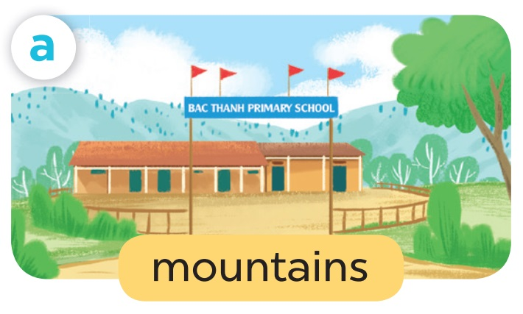
Where’s your school?
It’s in the mountains.

Slide 14
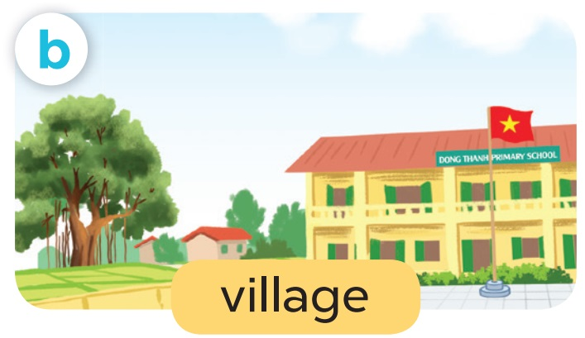
Where’s your school?
It’s in the village.

Slide 15
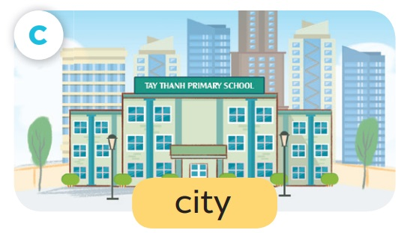
Where’s your school?
It’s in the city.

Slide 16
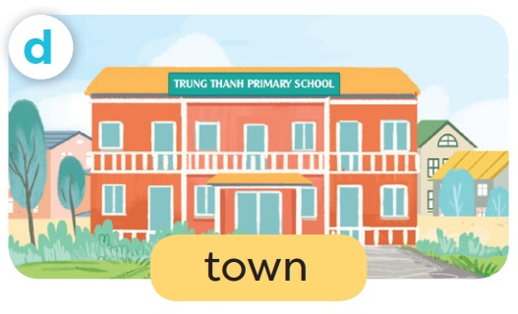
Where’s your school?
It’s in the town.

Slide 17
04
Activity 3
Let’s talk.

Slide 18
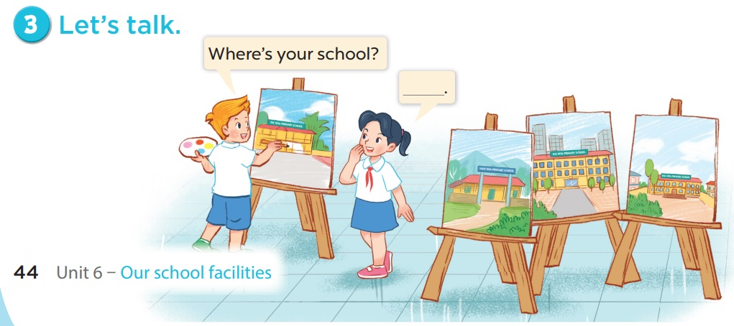

Slide 20
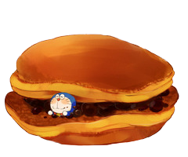
= Mystery
power-up
= points

Slide 21
O
P
Q
R
S
T
U
V
W
X
Y
Z
End game

Slide 22
- _____ is your school?
- It’s in the city.
Where

Slide 24
- Where is your school? - It’s in the ____.
city

Slide 26
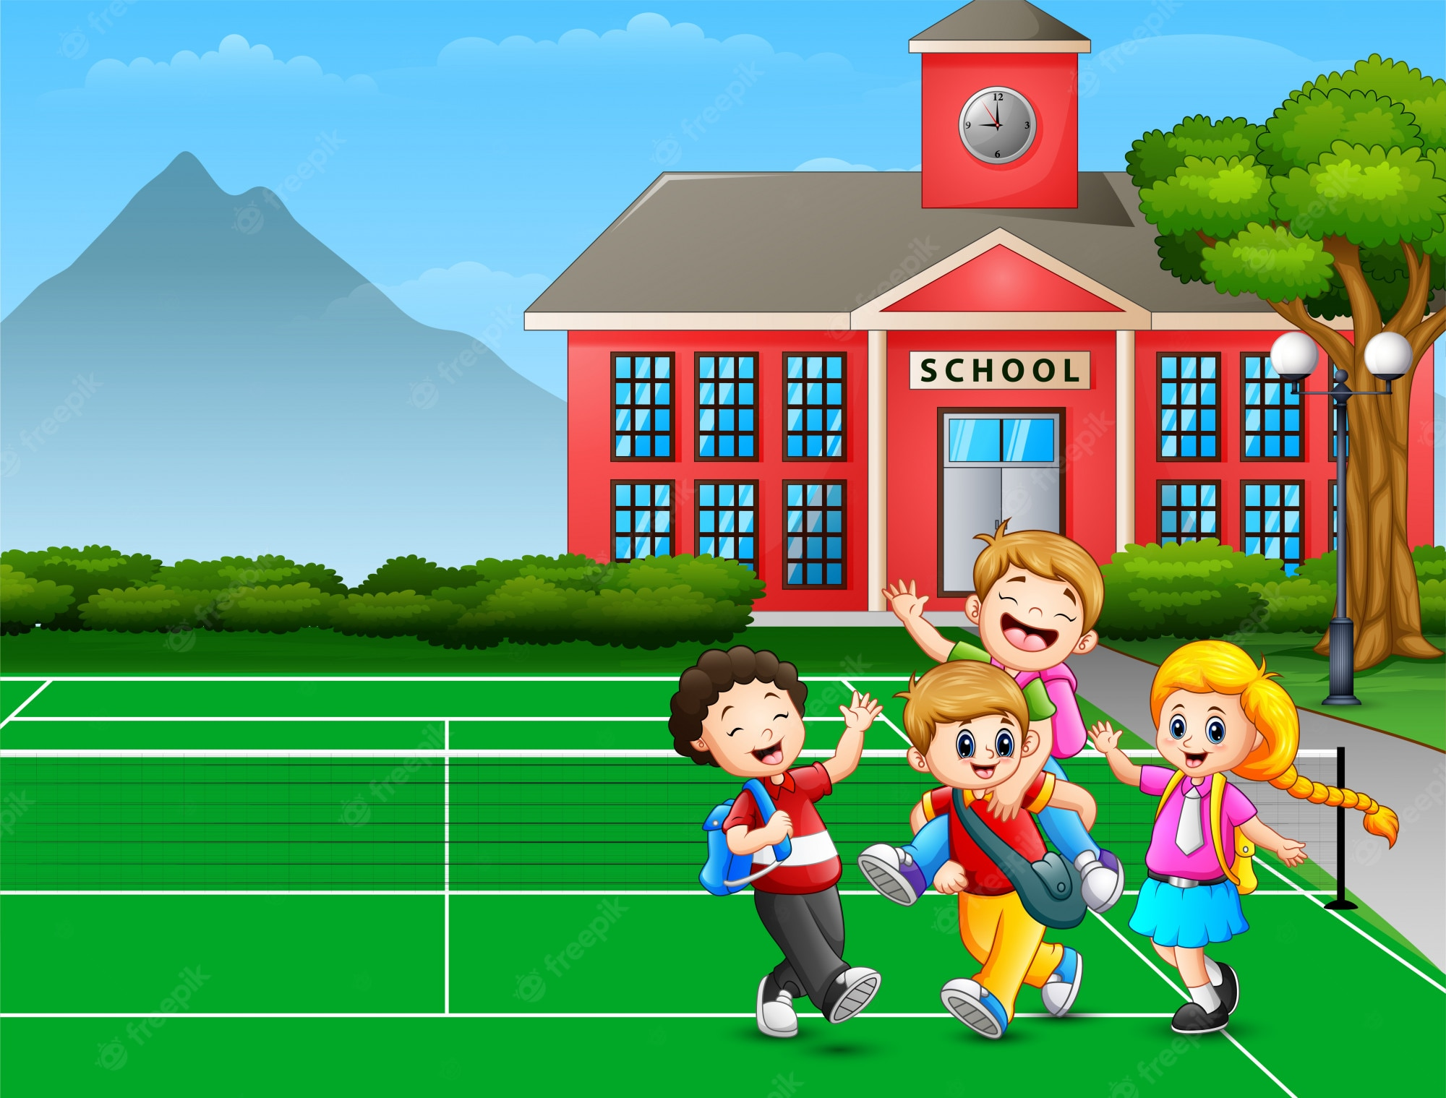
- Where’s your school?
- ______________.
It’s in the mountains.

Slide 28
Where are the children?
A. At home. B. At school.
B. At school.

Slide 30
How many children are there at the playground?
There are four.

Slide 32
- Is it a village?
- _________.
Yes, it is.

Slide 34
- Where is the Minion?
- _____________.
It’s in the village.

Slide 36
It’s a village.
A
B
A

Slide 38
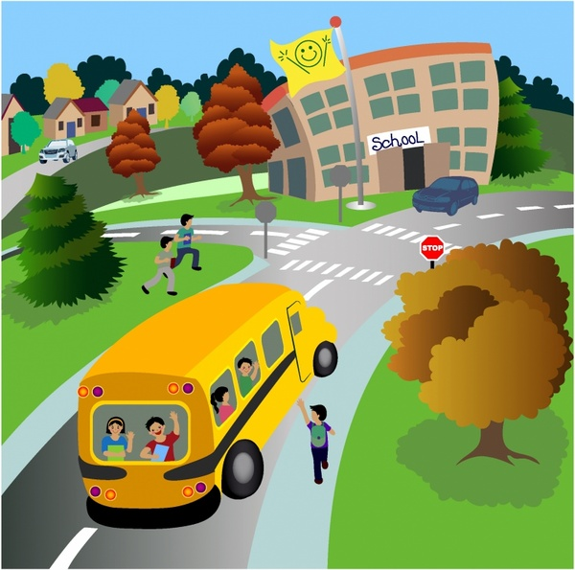
- Is it a city? - ______.
No, it isn’t. It’s a town.

Slide 40
My school is in the mountains.
A
B
B

Slide 41
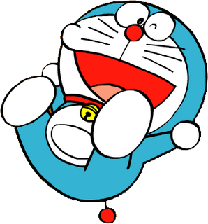

Slide 42
Change points!

Slide 43
Steal 3 points!

Slide 44
7 points!

Slide 45
Where is the school?
It’s in the town.

Slide 46
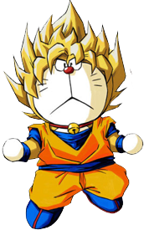
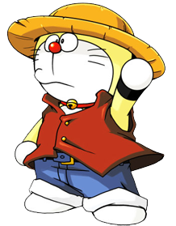

Slide 47
Steal 3 points!

Slide 49
9 points!

Slide 50
town / the / in / school / is / My /.
My school is in the town.

Slide 51
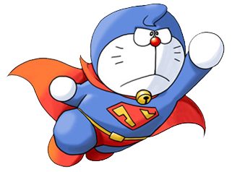

Slide 52
10 points!

Slide 53
Change points!

